Slide 1
TEAM
NAME : TEAM01NOV16
MEMBERS: ABHISHIKTH KALLURU
AVINASH RAJEEV
GITHIN SHAJI
RAVI TEJA KAMBALA

Slide 2
INTRODUCTION
KAO PIO
WEBSITE LOCATED IN BRISBANE CBD

Slide 3
Flow Hierarchy
HomePage
Home Page
Menu
Search
Registration
About Us
Login
Social Media

Slide 4
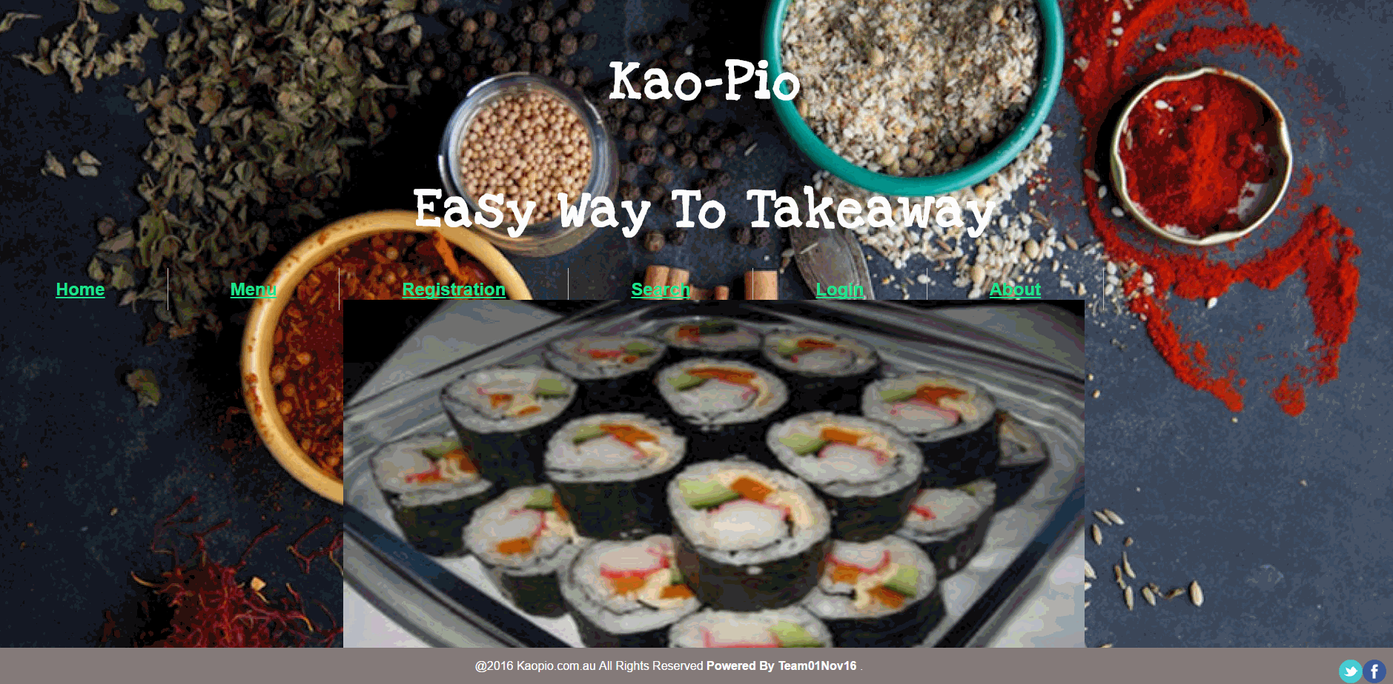
Home Page
Notes:
http://10.250.0.9/Team01nov16/ProjectFinalStage/index.html

Slide 5

Menu Page

Slide 6
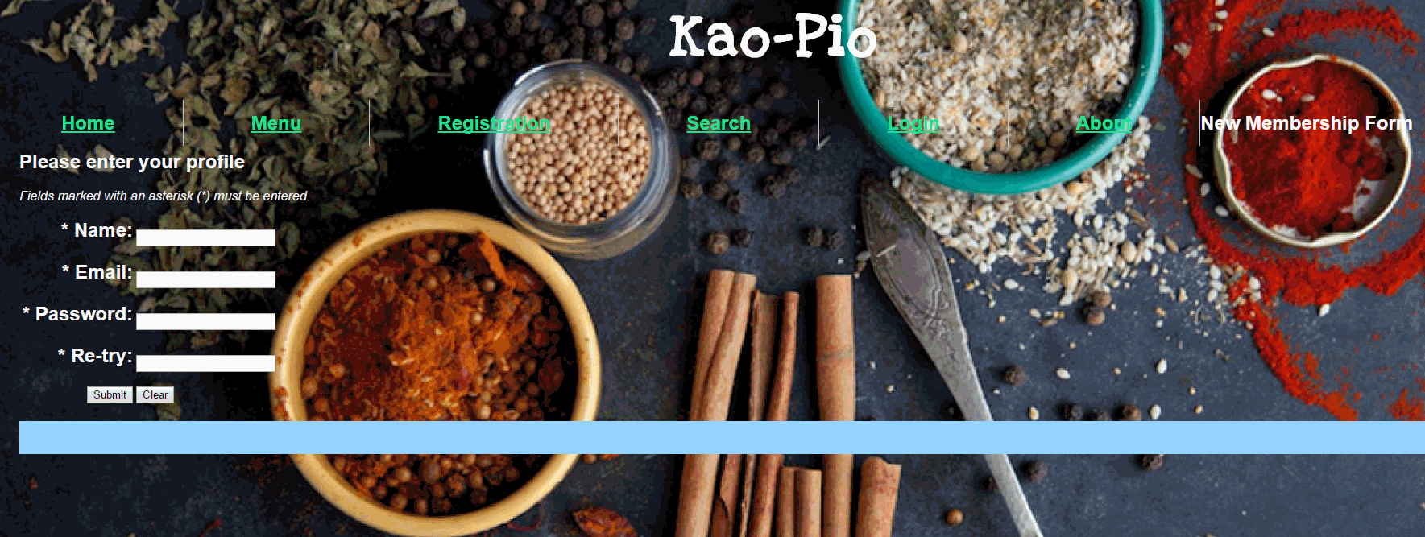
Registration

Slide 7

Search Page

Slide 8
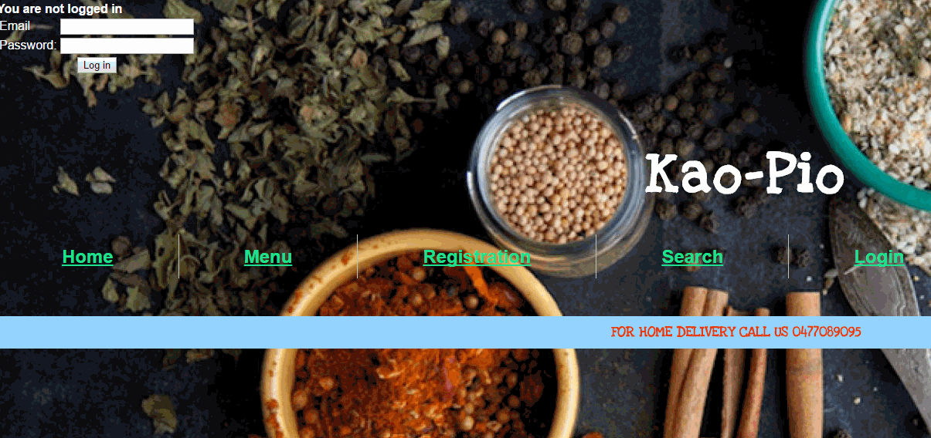
Login Page

Slide 9
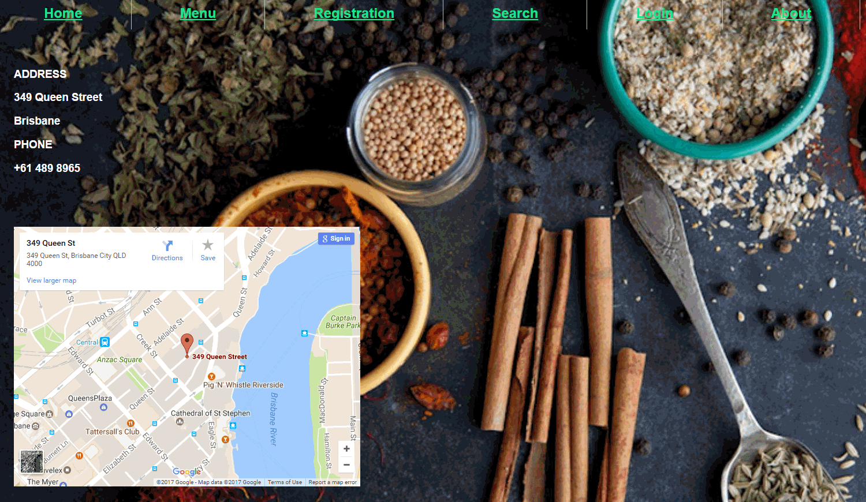
About US

